Slide 1

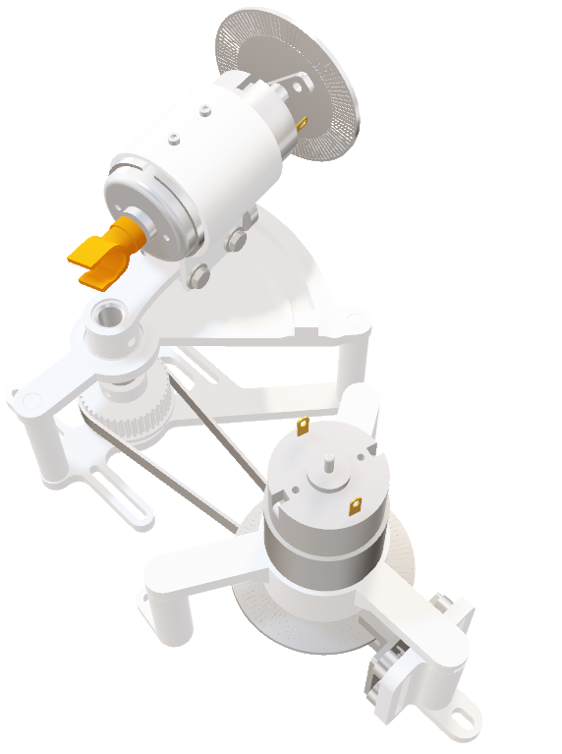
Laser Light Show MILESTILE II ELEC 391 TEAM B1 × CONTROLLER
Muchen He 44638154 LuFei Liu 14090154

Slide 2
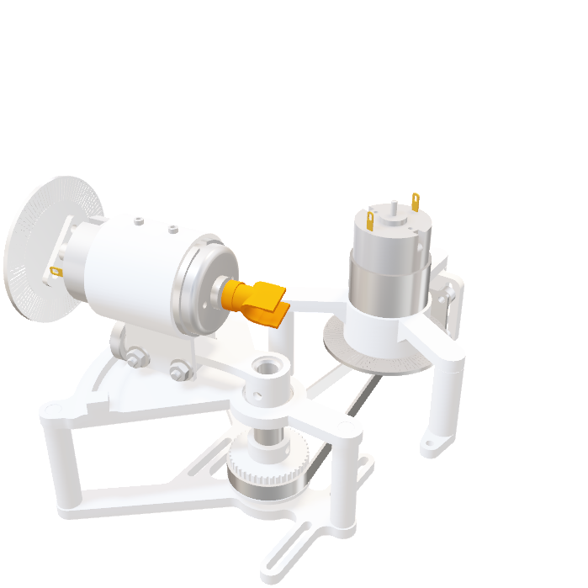
RCGs
Requirements
Usable PID Values Obtained
Encoder Detects All Pulses
Constraints
Control Frequency of 1000 Hz
Max Motor Current ( < 2A )
Goals
Rise Time ( < 0.017 s )
Overshoot ( < 10 % )
No Breadboards
Max Encoder Resolution ( 400 pulses )
Simulink Model of Motor Within 5 % Error
Support shapes with >5 vertices

Slide 3
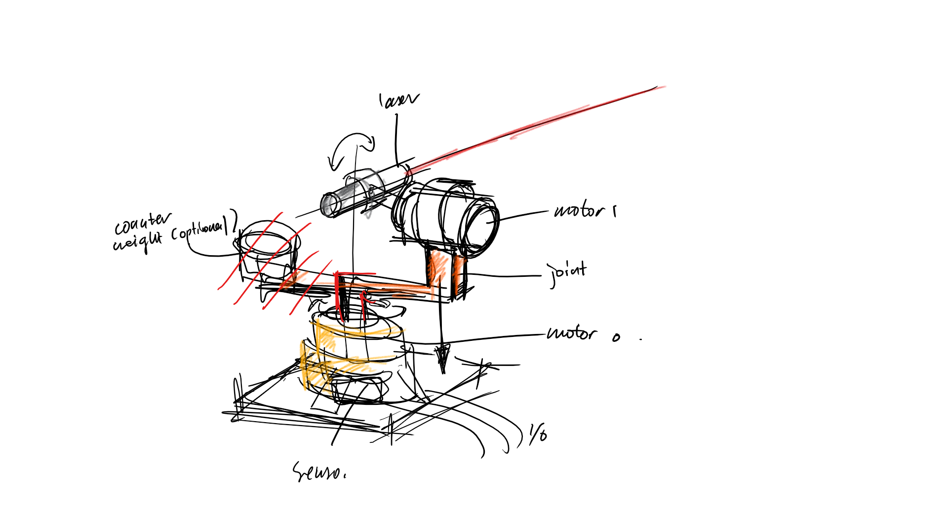
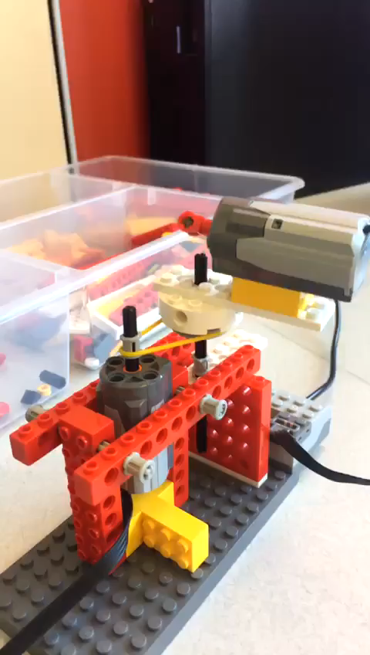
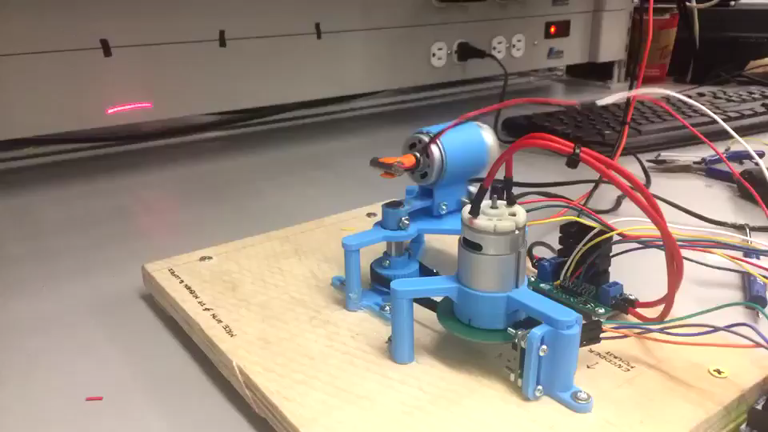
PROGRESSION
INITIAL SKETCHES
LEGO PROOF OF CONCEPT
MILESTONE RESULT

Slide 4

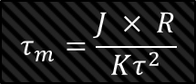
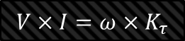
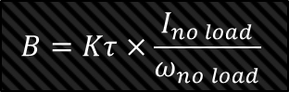
MOTOR PARAMETERS
R, L (8.4 $Ω$ , 1.12mH)
Measured using multimeter and oscilloscope
R, L (8.4 Ω , 1.12mH)
Measured using multimeter and oscilloscope
$Kτ$ ( 23.54 $\frac{mNm}{A}$ )
Torque determined from conservation of power
Kτ ( 23.54 mNm/A )
Torque determined from conservation of power
B ( 4.964 $×{10}^{−6}$ $\frac{kg m^{2}}{s}$ )
Kinetic friction from $\frac{torque}{speed}$ at no load conditions
B ( 4.964 ×〖10〗^(−6) (kg m^2)/s )
Kinetic friction from 𝑡𝑜𝑟𝑞𝑢𝑒/𝑠𝑝𝑒𝑒𝑑 at no load conditions
Kv ( 628.5 $\frac{RPM}{V}$ )
Back EMF calculated using KVL
Kv ( 628.5 RPM/V )
Back EMF calculated using KVL
J ( $5.93×{10}^{−6}$ $kg m^{2}$ )
Calculated from mechanical time constant (time to reach 63% of final speed)
J ( 5.93×〖10〗^(−6) kg m^2 )
Calculated from mechanical time constant (time to reach 63% of final speed)
Resistance and Impedance
Torque Constant
Rotor Inertia
Back EMF
Kinetic Friction
$$V×I=ω×K_{τ}$$
$$τ_{m}=\frac{J × R}{Kτ^{2}}$$
$$V_{\text{measured}} −I×R=K_{v}×ω$$
$$B=Kτ×\frac{I_{no load}}{ω_{no load}}$$

Slide 5
SPEED REDUCTION
1:3½ ratio
Encoder wheel resolution increased by 3.5
Torque increased by 3.5
GT2 timing belt profile
Custom high resolution 3D printed belt drives
1
:
3½

Slide 6
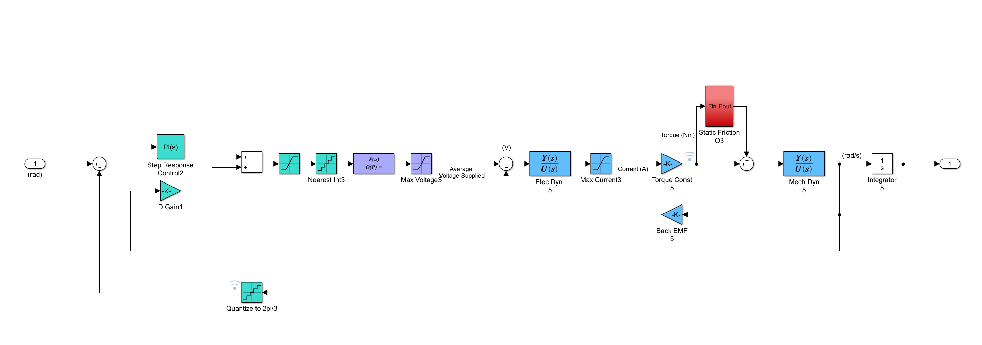
Simulink Model with PID Control
Static Friction and Cogging
PWM Value between
0 - 255
Maps PWM to Average Voltage
Output Position
Input Step
Derivative Gain on Velocity
Quantizes Angle to Encoder Resolution
Motor Transfer Function

Slide 7

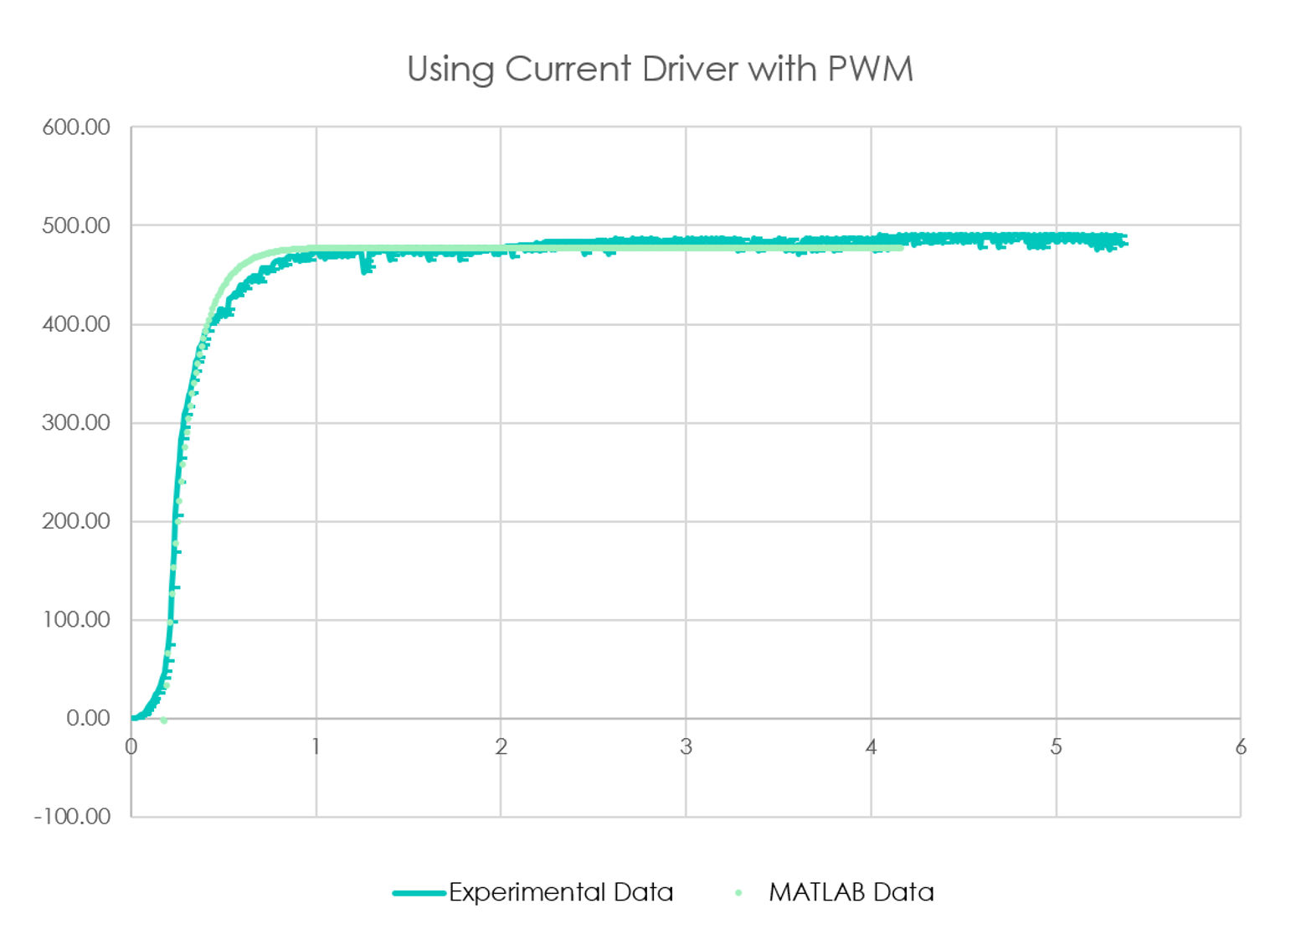
OPEN LOOP RESPONSE
Open loop response data is used to verify adequacy of obtained motor parameters

Slide 8
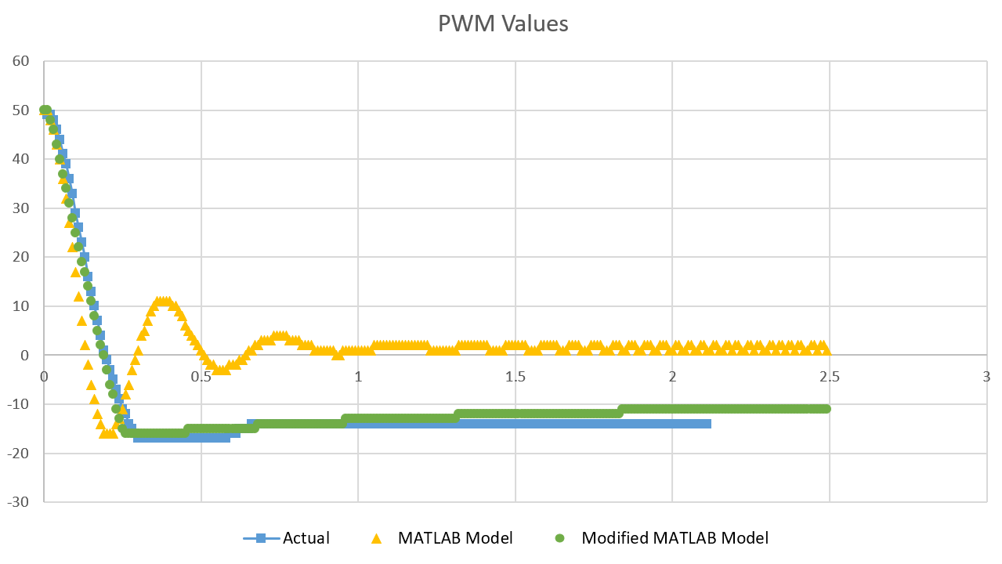
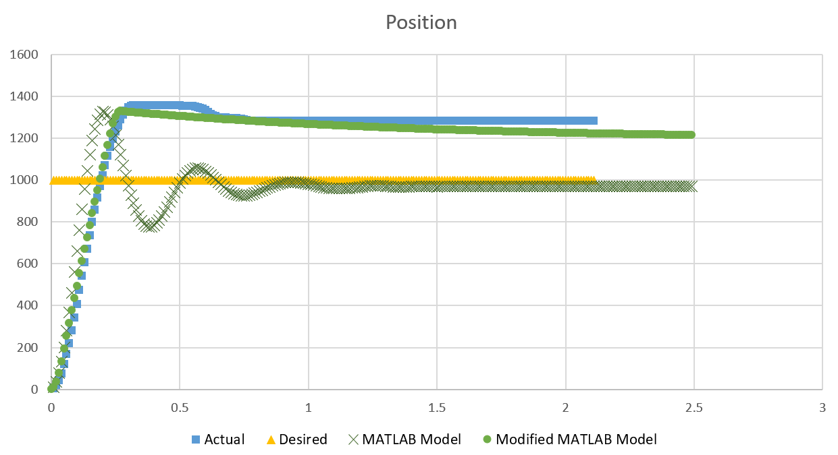
P CONTROL
Modified MATLAB Model accounts for values of PWM less than 30 being too low to overcome cogging and static friction

Slide 9
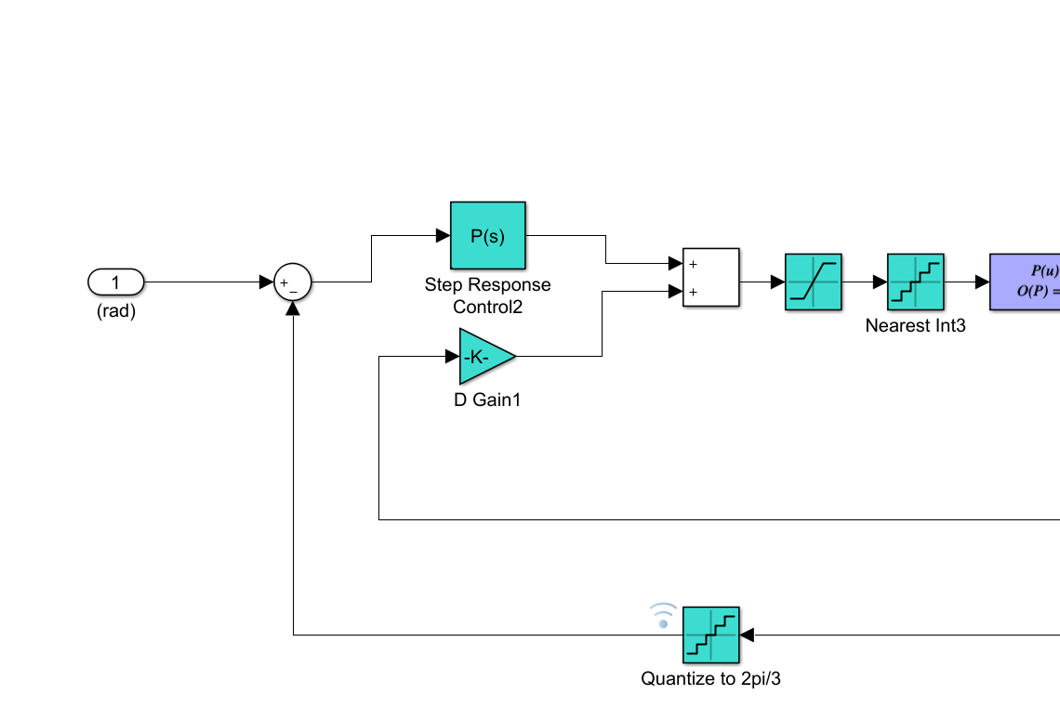
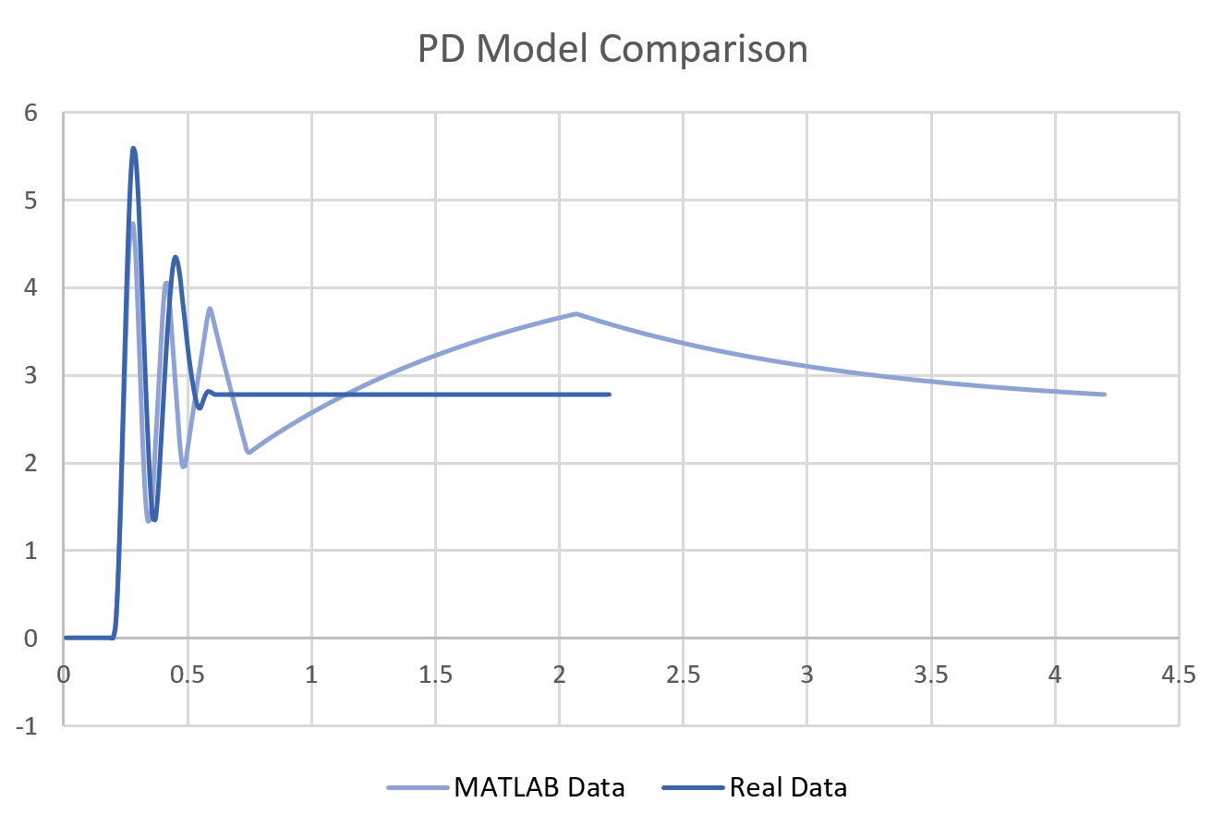
PD CONTROL
Simulink model adjusted for derivative control on current velocity instead of rate of error change
This results in a negative derivative gain

Slide 10
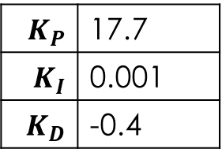
INITIAL CONTROL
Obtained in MATLAB
Aim for fastest rise time and small overshoot
Ensure system is stable
$K_{P}$ | 17.7
$K_{I}$ | 0.001
$K_{D}$ | -0.4
Overshoot | 14.28 %
Rise Time | 0.1 s
Settle Time | 2 s

Slide 11

PERFORMANCE
Tested on the pitch motor
Used PID values obtained in MATLAB
Measured performance by sampling position via controller
$K_{P}$ | 17.7
$K_{I}$ | 0.001
$K_{D}$ | -0.4
Overshoot | 2 %
Rise Time | 0.15 s
Settle Time | 0.12 s

Slide 12
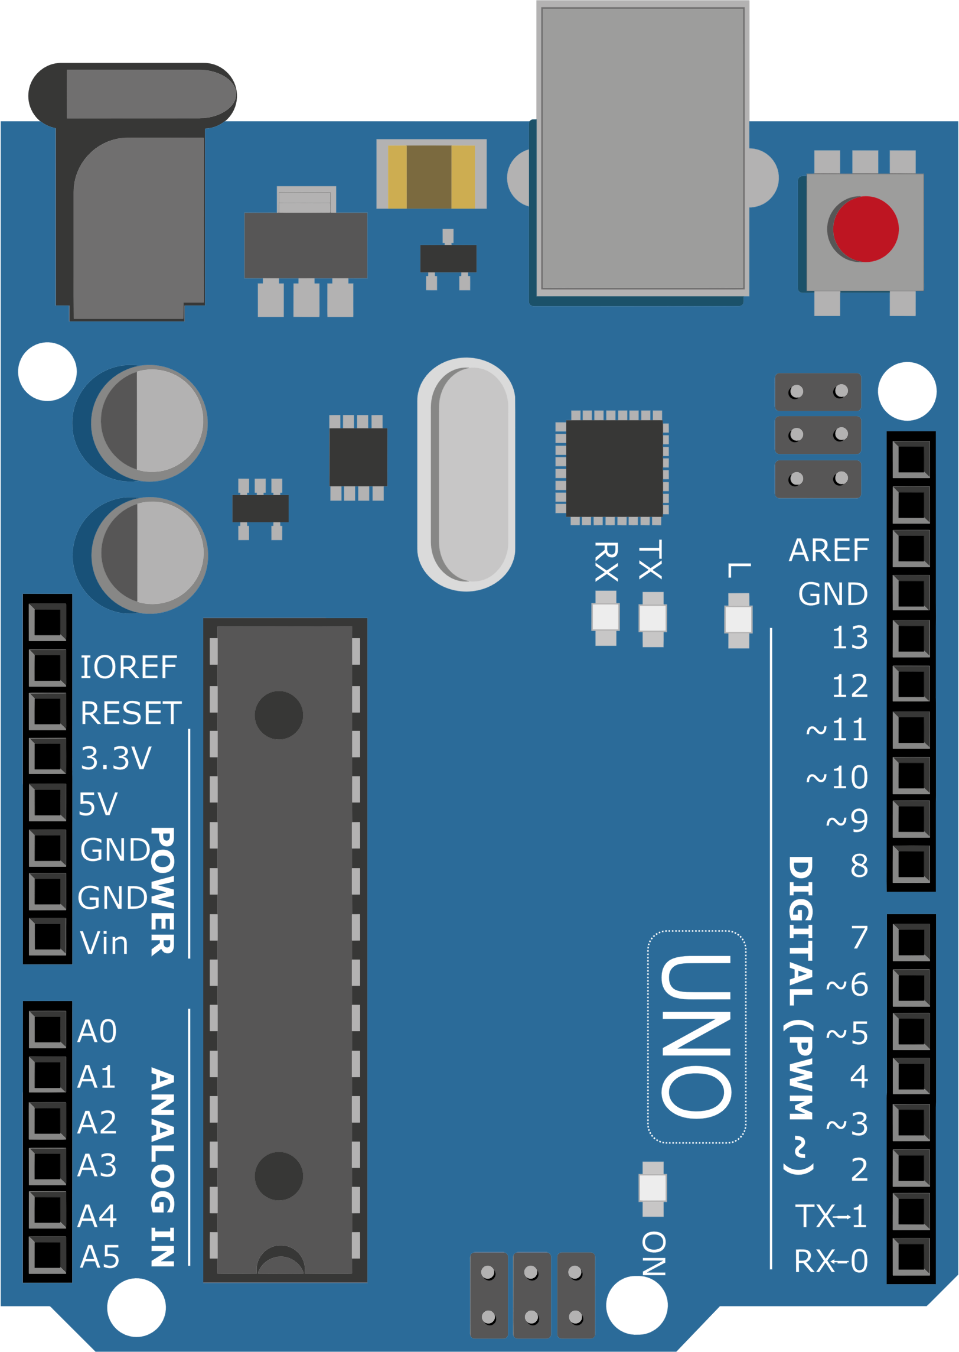
MICROCONTROLLER
Arduino Uno and Arduino Nano is chosen for its ease of use and safety features
Considered using FPGA for hardware accelerated tasks but compilation is too slow and debugging is difficult ×
Considered using 8051 microcontroller but setup is too cumbersome and does not support C++ software ×
Laser control
Sensor input
Motor direction control
PWM motor control
Homing detect
Pin Configuration

Slide 13



CONTROLLER LOGIC
Sensor Input
Proportional
Error = desired position - current position
× proportional gain
Integral
Summation of error at control frequency
× integral gain
Derivative
Sample speed at control frequency
× derivative gain
Timer ISR
1000 Hz
Output Logic
+

Slide 14
QUADRATURE DECODING
State Machine
Software Implementation
Extremely fast ISR
No quadrature decoder hardware needed
Faster than using quadrature decoder
State 01
State 11
Slot Detector A Interrupt
Slot Detector B Interrupt
State 00
State 10
A XOR B == 00 ?
Read Encoder B
A XOR B == 00 ?
Position++
Position--
Read Encoder A
Position++
Position--
Increment
State
{A, B}
Decrement
End ISR
End ISR

Slide 15
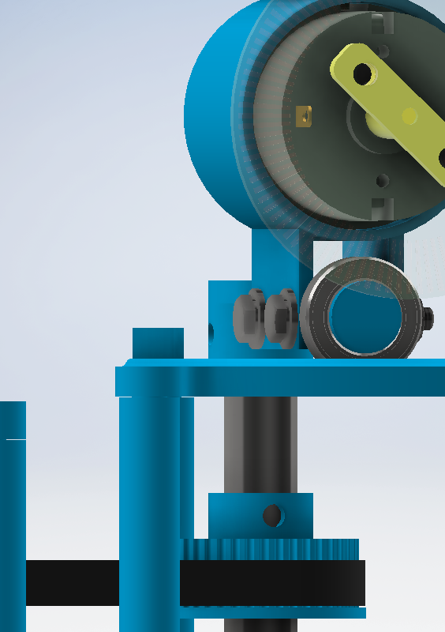
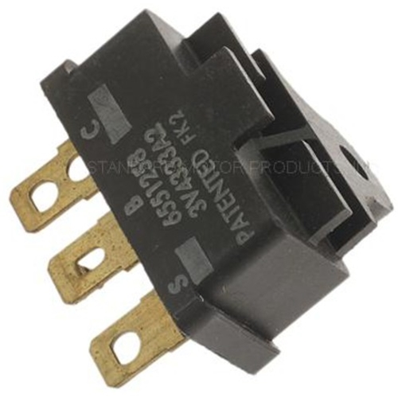
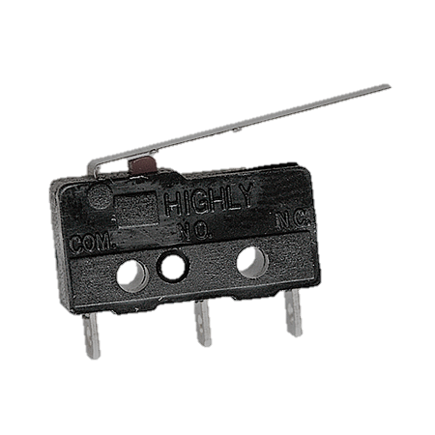
POSITION HOMING
Installed limit switch at the end
Trigger event is done by polling at the start
Reliable position reset routine
Move motor until switch is triggered
Stop and reset motor home position
Proceed to normal operation

Slide 16



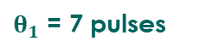
SHAPE VERTEX MAPPING
Map desired laser path to list of coordinates in custom-written software
Inverse kinematics are applied to obtain angles
Angles are converted to encoder positions
Time vector is generated based on length of each line segment
1
2
EXPORT
Position: x and y are exported in two arrays of floats
Time Vector: relative time between commands are exported in an array of integers
The exported data is in a .h file compiled to the controller
-0.7, 0.6
-0.7, 0.6
$$θ_{2}$$
0.8, -0.2
$$θ_{1}$$
0.8, -0.2
3
4
$$θ1$$
A
95 ms
B
105 ms
$θ_{1}$ = 7 pulses
C

Slide 17
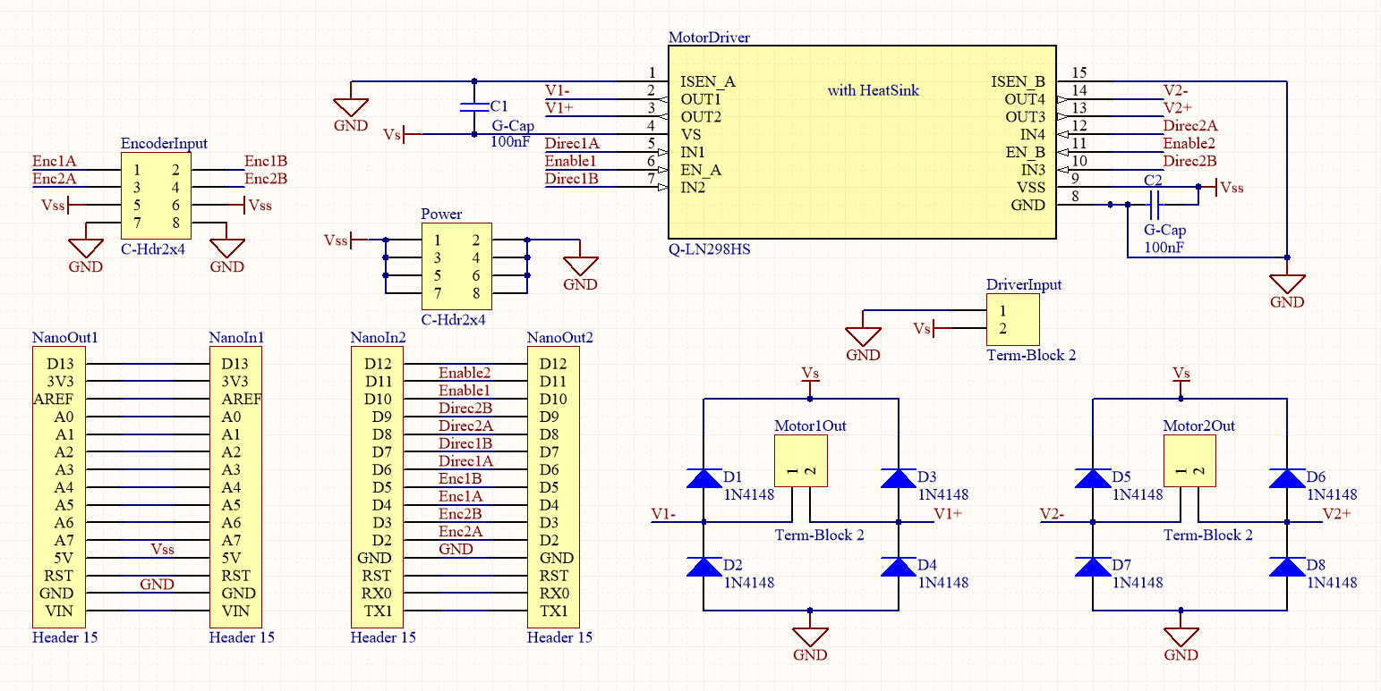
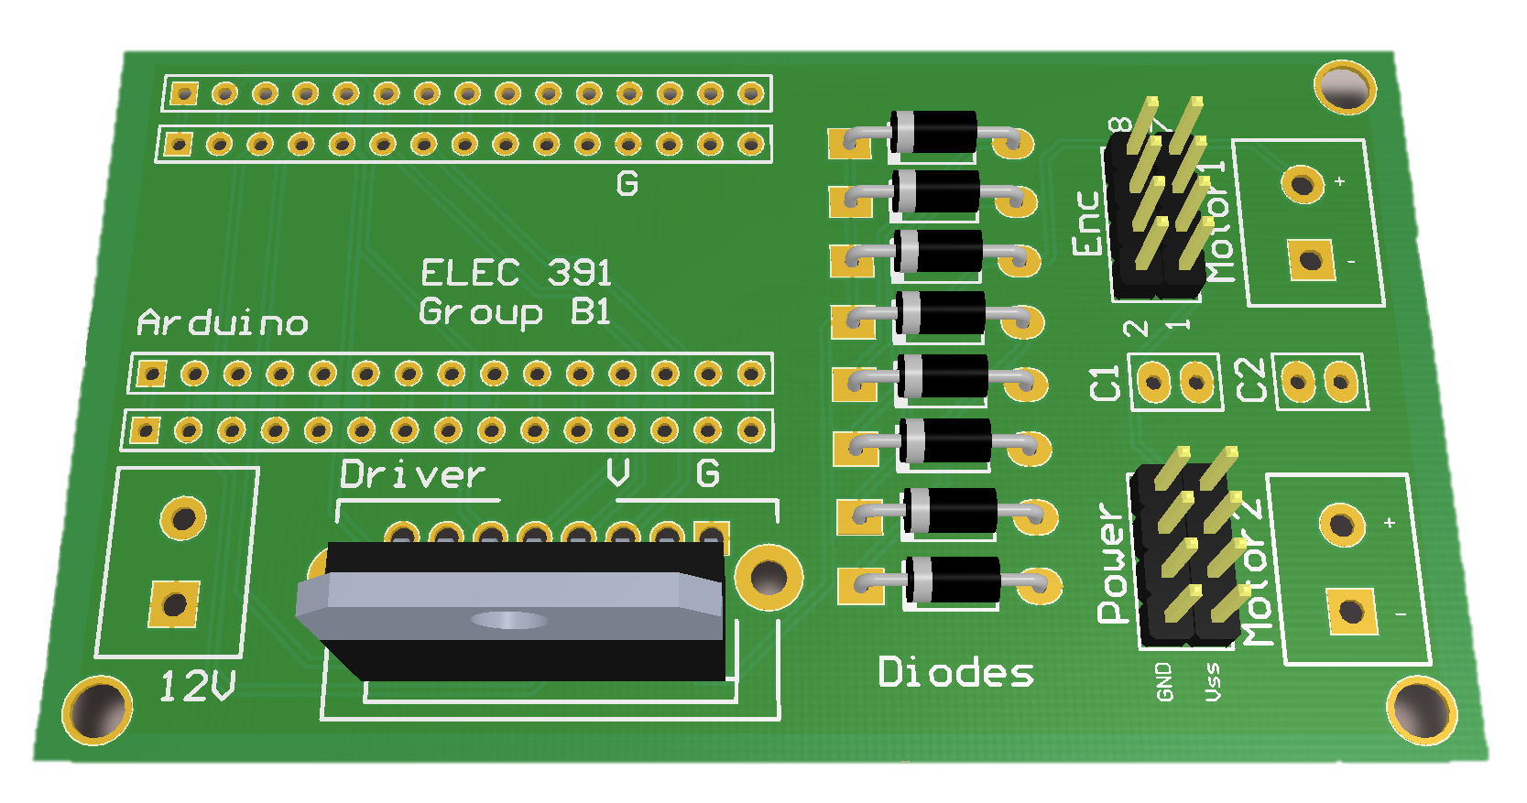
SYSTEM PCB
Current Driver
Pins from Encoder
Extra 5V Pins
12V Input Pins
Arduino Base
Diode Bridge

Slide 18
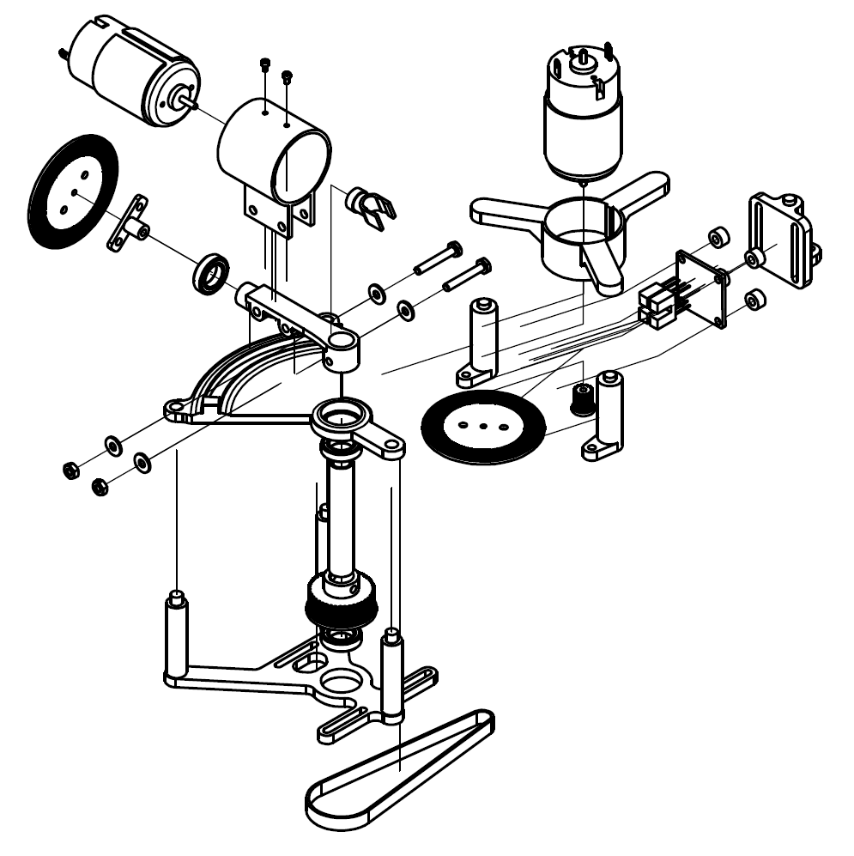

MECHANICAL FEATURES
Slot detector circuit mount with slots for height adjustment
Interchangeable motor adapter
Custom encoder wheel adapter
Eccentric standoffs for easy positioning
Laser mount
Fastener slots for belt tension adjustments
Movement track to reduce stress on the shaft
Timing belt with 3½:1 ratio

Slide 19
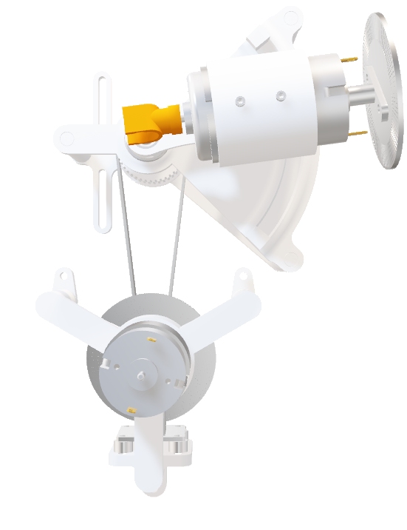
INTEGRATION
Integrate motors manufactured by motors sub-team
Obtain new motor parameters
Update system model
Adjust mechanical design
Retune PID controller

Slide 20
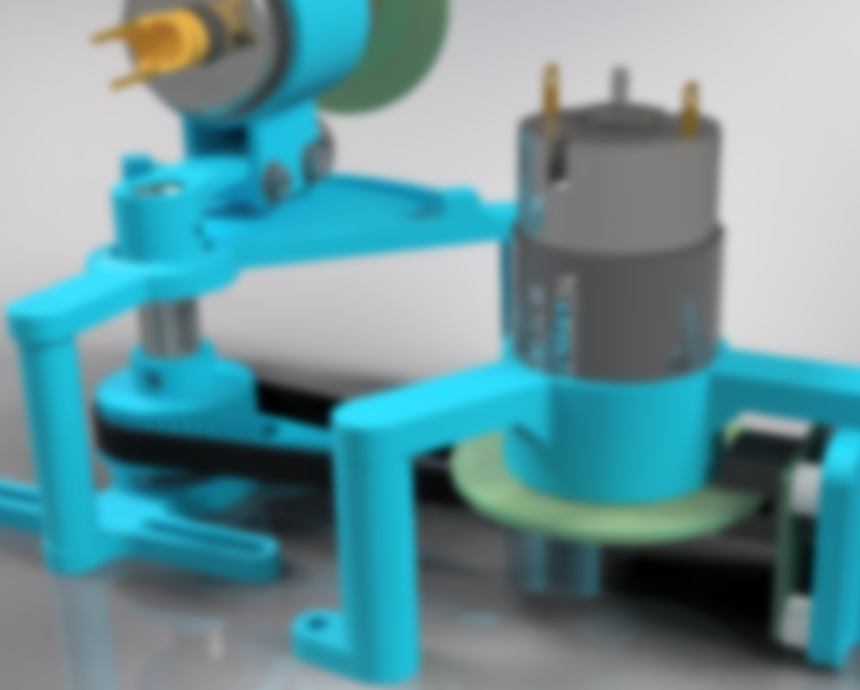
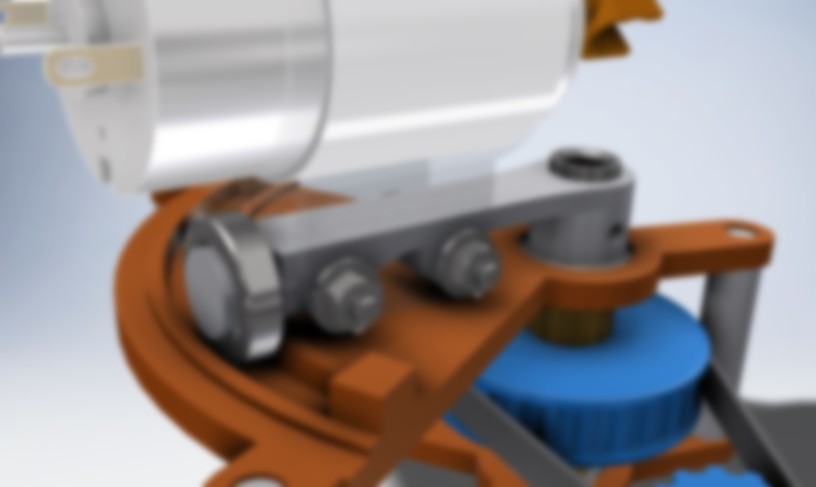
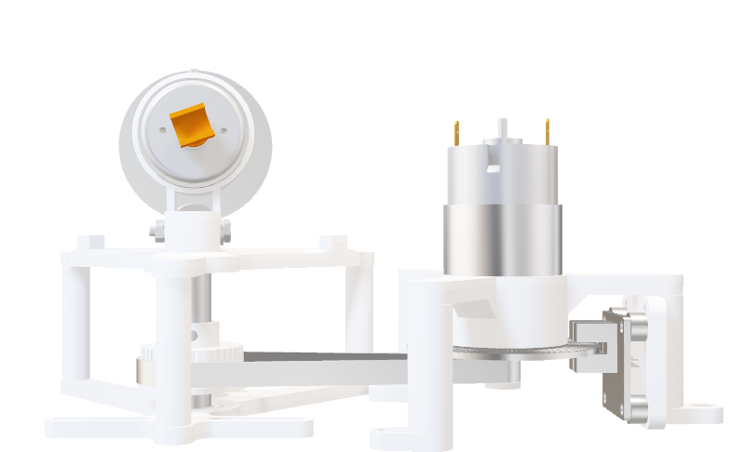
ELEC 391 TEAM B1 × CONTROLLER
Capable of 2 degree-of-freedom movements
PID controlled yaw motor
Fast and accurate positioning with minimum overshoot
Accurate system model
Modular design
Muchen He 44638154 LuFei Liu 14090154

